Slide 1
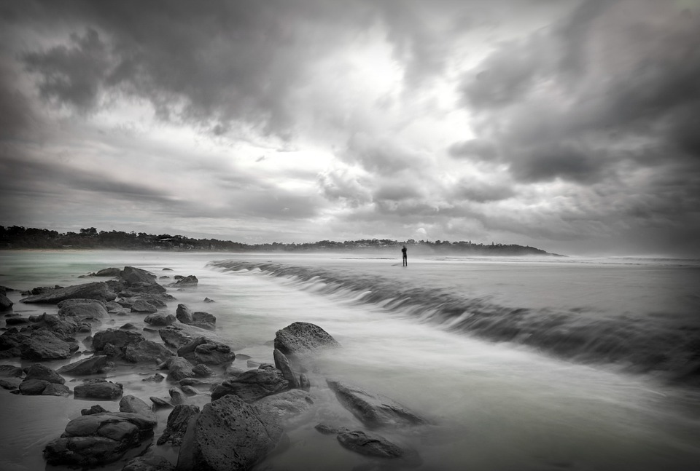
Mystery Game
Challenge
By Keiron Jerome and James Gangavarapu

Slide 2
Mystery Game Challenge
On your way to a weekend cabin retreat in the mountains you encounter a storm and lose contact with your friends. After the storm subsides you try to locate your girlfriend and her sister.

Slide 3




1. Intro
Choose an approach to get to your girlfriend and her sister.
Clue Marker Indicates a clue to decipher and follow
Navigation Arrows Helps you move around the space and go back to where you came from
Hidden Clues

Slide 4
DEMONSTRATION

Slide 5
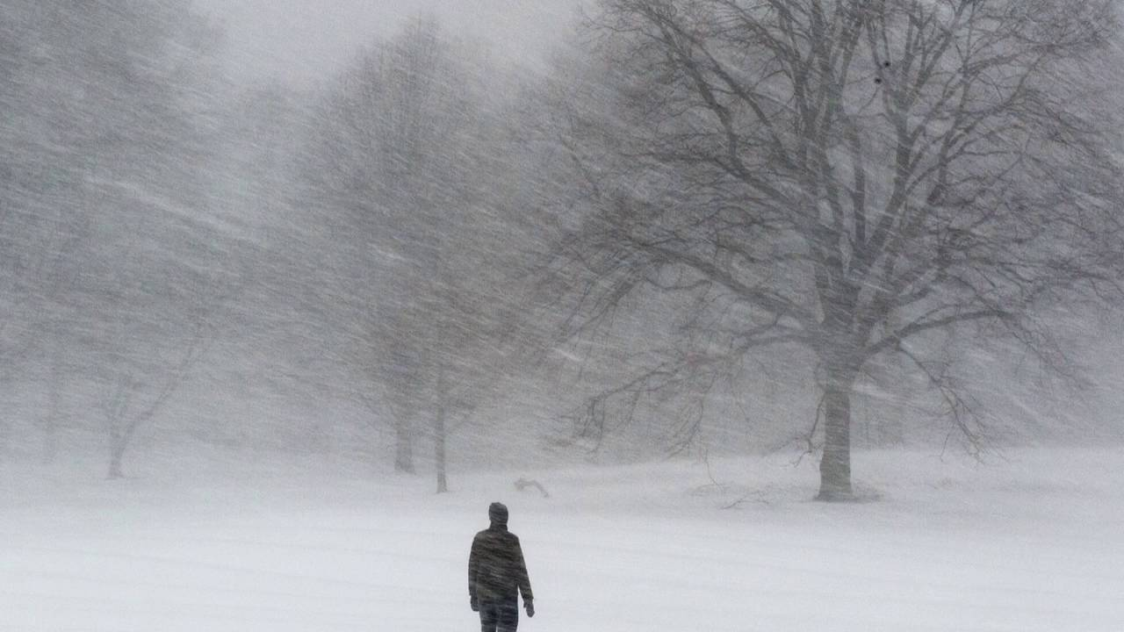
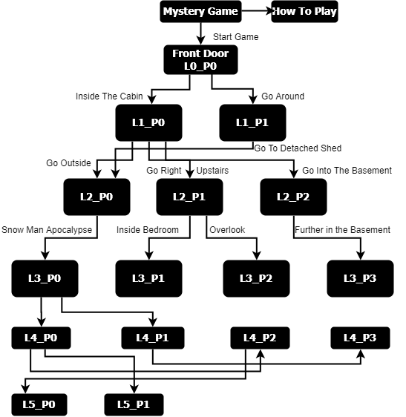
Game Flow

Slide 6
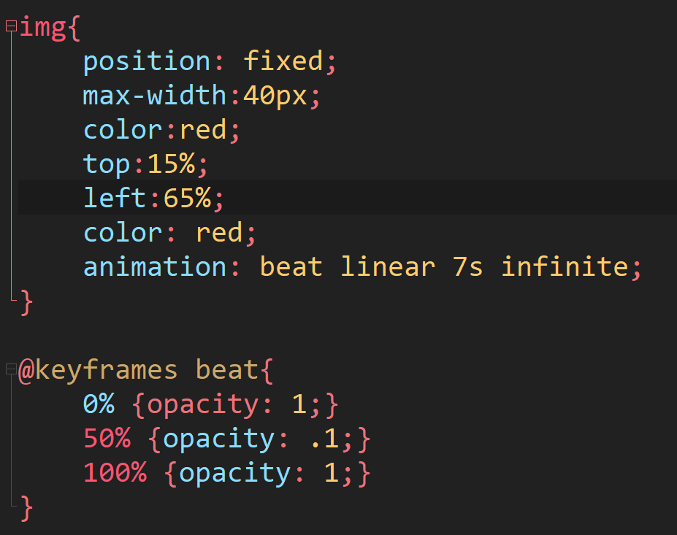
2. Sample Code
Animation
What img
How

Slide 7


Meet The Team
Keiron Jerome
James Gangavarapu

